Slide 1
Introduce to Edge Detection
黃品文

Slide 2
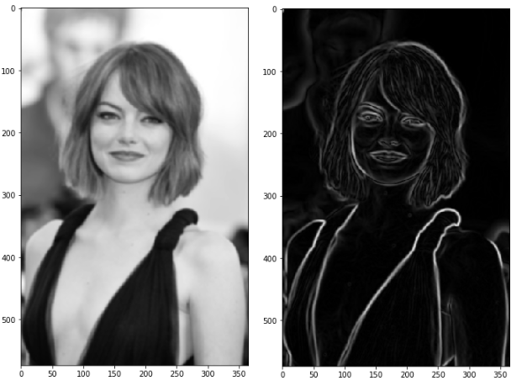
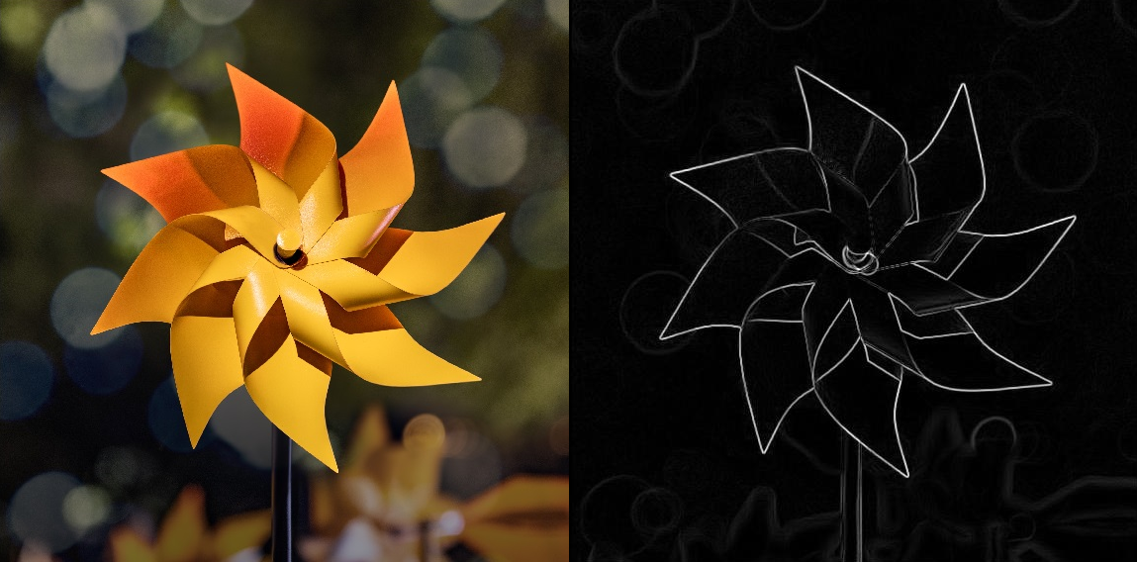
Edge detection
A important task in computer vision and image processing
Detect edge feature in image
https://towardsdatascience.com/canny-edge-detection-step-by-step-in-python-computer-vision-b49c3a2d8123
https://towardsdatascience.com/edge-detection-in-python-a3c263a13e03

Slide 3
Usage of Edge Detection[1]
image recognition
face recognition
image segmentation
corner detection
medical imaging
target tracking

Slide 4
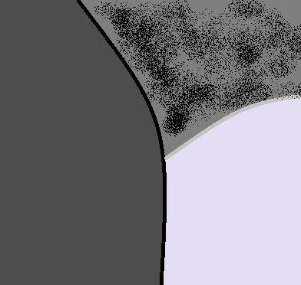
What is Edge?
The boundary between difference region
Usually characteristic

Slide 5
How to get good Edge? [1]
High accuracy
High localization accuracy
Robust to Noise
High efficiency
Real-time application
I will introduce some non-ML edge detection method

Slide 6
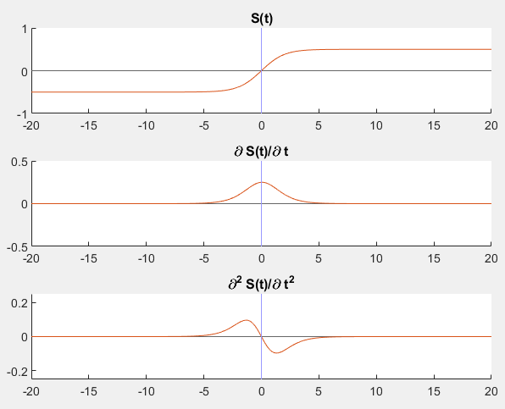
Gradient Method
Select the most steep pixels!
Threshold
Zero crossing
*[2]

Slide 7
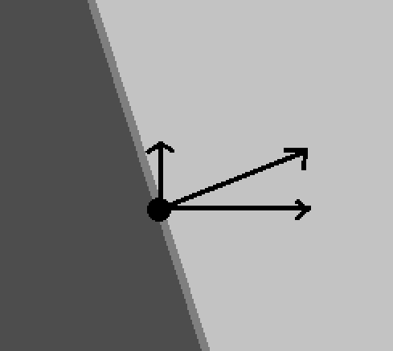
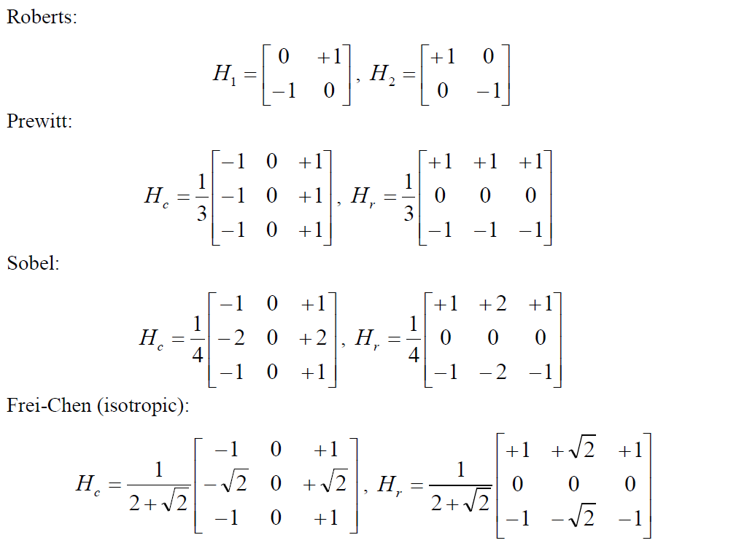
Gradient Method
Usually compute Gx and Gy$\left(\frac{∂I\left(x,y\right)}{∂x},\frac{∂I\left(x,y\right)}{∂y}\right)$
Compute by convolution
*Formula is from [2]

Slide 8
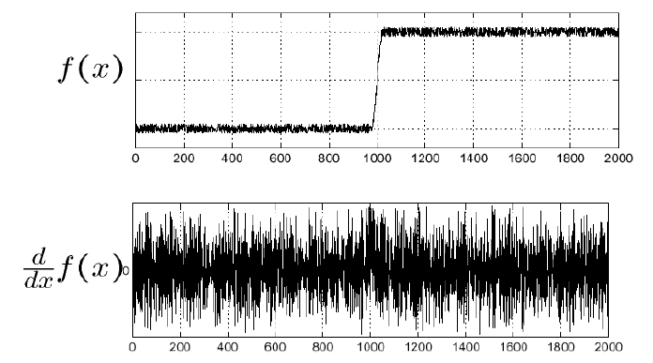
Gaussian Method
Try to fix the noise problem at gradient method.
* from [2]

Slide 9
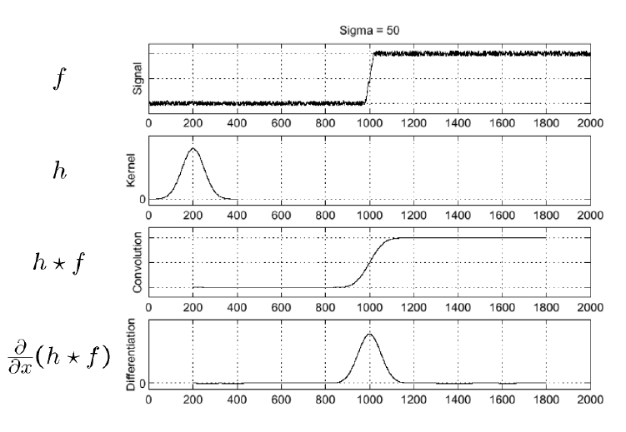
Gaussian Method
Using Gaussian Blur
* from [2]

Slide 10
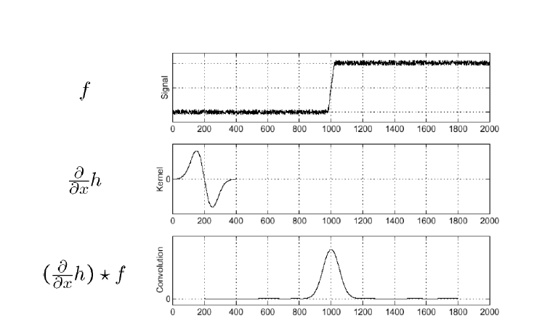
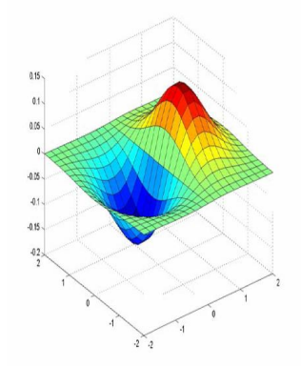
Gaussian Method
The image of Gaussian gradient detector
* from [2]
https://medium.com/jun94-devpblog/cv-3-gradient-and-laplacian-filter-difference-of-gaussians-dog-7c22e4a9d6cc

Slide 11
Canny Edge Detector[3]
A famous edge detector
Method:
2D Guassian blur → Gx,Gy → Non-maximum Suppression(NMS) → double-threshold

Slide 12
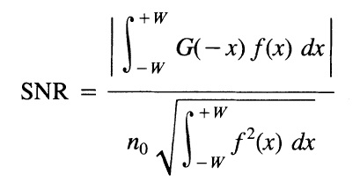
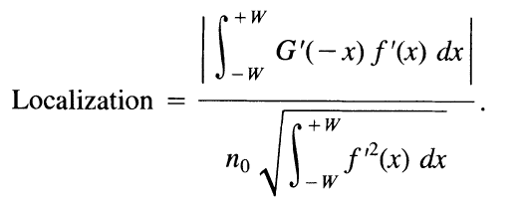
Canny Edge Detector
Math part:
I pass the prove
*All figure are from [3]

Slide 13
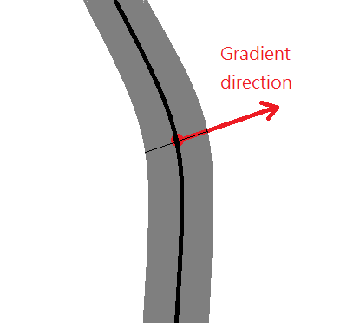
Canny Edge Detector
Non-maximum Suppression(NMS)
The same thing zero-crossing do

Slide 14
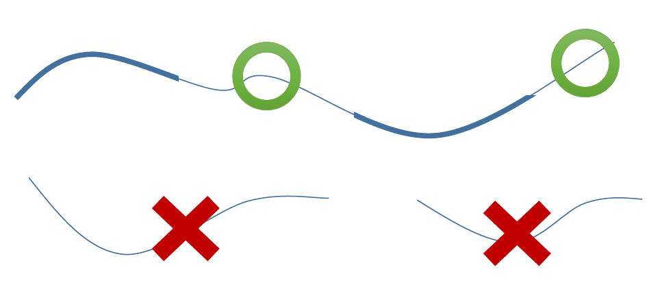
Canny Edge Detector
Double-threshold
*It an image find in my old note,
so I forgot where this image from, sorry

Slide 15
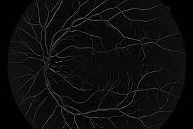
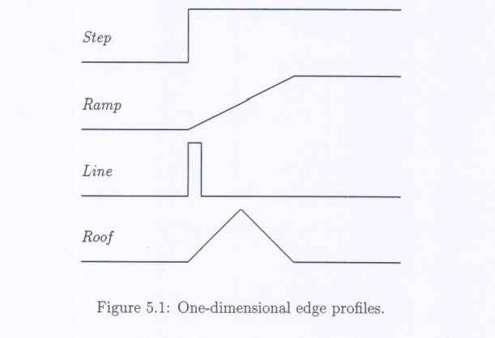
Ridge
What is Ridge?
edge
ridge
https://anirban-karchaudhuri.medium.com/edge-detection-methods-comparison-9e4b75a9bf87
https://arxiv.org/pdf/1809.08678.pdf

Slide 16
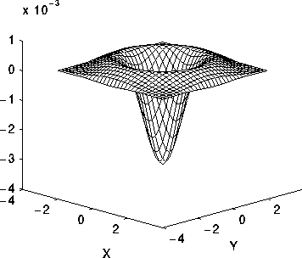
Ridge
Laplacian of Gaussian
Hilbert transform[1]
Convert odd-symmetric filter to even-symmetric
https://homepages.inf.ed.ac.uk/rbf/HIPR2/log.htm

Slide 17
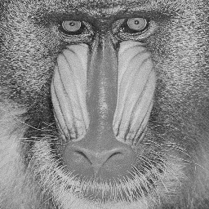
Texture Method
Use texture to distinguish different regions
And some time it’s not edge!

Slide 18
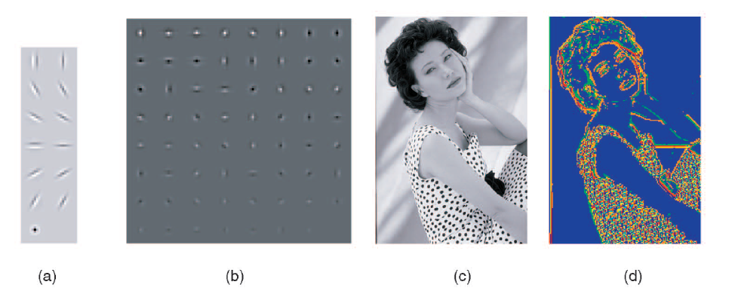
Texture Method
Using textons to get the texture feature of image[4]
Convert to vector
Then compute distance between different vector(L1 Norm, $χ^{2}$ difference)

Slide 19
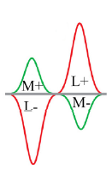
Color Method
Human vision method[5]
Other color space (Lab)
Color Histogram [4]
$I(x,y) = \left[\begin{matrix}R(x,y) \\ G(x,y) \\ B(x,y)\end{matrix}\right]$
*From [5]

Slide 20
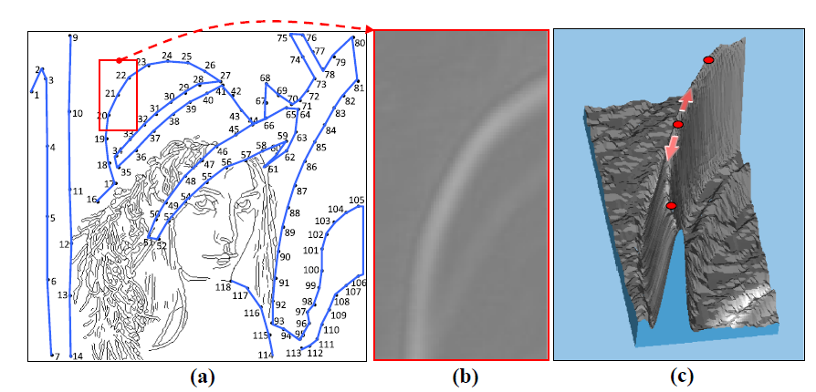
Line Method
Edge Drawing[6]
(Human way!)

Slide 21
Some problem
Scale
*Image of BSDS500

Slide 22
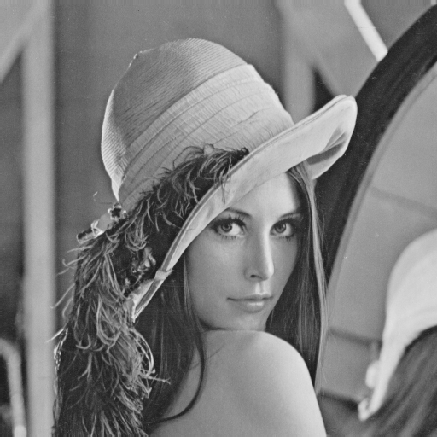

Slide 23
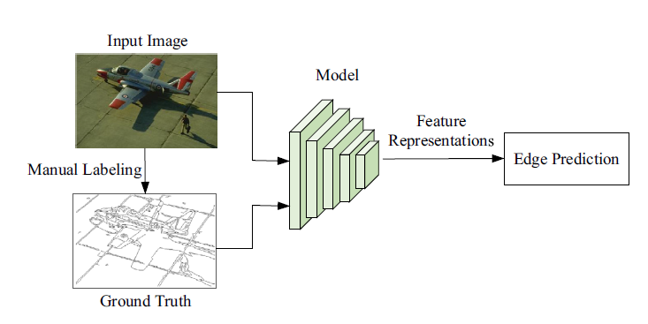
ML method
CNN…
* from [1]

Slide 24
Reference
[1] J Jing, S Liu, G Wang, W Zhang, C Sun - "Recent advances on image edge detection: A comprehensive review", Neurocomputing, 2022
[2] MA Oskoei, H Hu - "A survey on edge detection methods", University of Essex, UK, 2010
[3] J Canny - "A computational approach to edge detection", IEEE Transactions on pattern analysis and machine intelligence, 1986
[4] DR Martin, CC Fowlkes, J Malik - "Learning to detect natural image boundaries using local brightness, color, and texture cues", IEEE transactions on pattern analysis and machine intelligence, 2004
[5] K Yang, S Gao, C Li, Y Li - "Efficient color boundary detection with color-opponent mechanisms", Proceedings of the IEEE Conference on Computer Vision and Pattern Recognition (CVPR), 2013
[6] C Topal, C Akinlar - "Edge drawing: a combined real-time edge and segment detector", Journal of Visual Communication and Image Representation, 2012

